Slide 1

BDAT 1004 – Data Programming – S2022
Lecture #3: Imperative Programming/Text Data, Files, Exceptions
Professor Roshan Sahu
Wednesday, September. 21st, 2022 @ 7-10PM EST

Slide 2
Agenda
Announcements and How to Submit Problem Set
About Python
Algebraic Expressions
Strings, Arrays, Indexing, Boolean Operators, Lists
Classes
Imperative Programming
If Else Logic
Text Data, File I/O, and Exceptions
Practice Questions (Optional and Highly Recommended)

Slide 3


Slide 4

Python Wikipedia Activity

Slide 5
Announcements and How To Submit Problem Set
1
Notes:
First Week of Python
First Problem Set is Due Next Week Tuesday May 31st 11:59pm
Course contracts must be signed and uploaded to blackboard or else your assignments won't be marked
Link to python text books under About this Course Link
Don't forget todays quiz
We will cover how to submit your assignments next
The main pillars of learning programming — and why beginners should master them.
Exercises throughout the jupyter notebook shared for this lecture! Also shared at the end

Slide 6
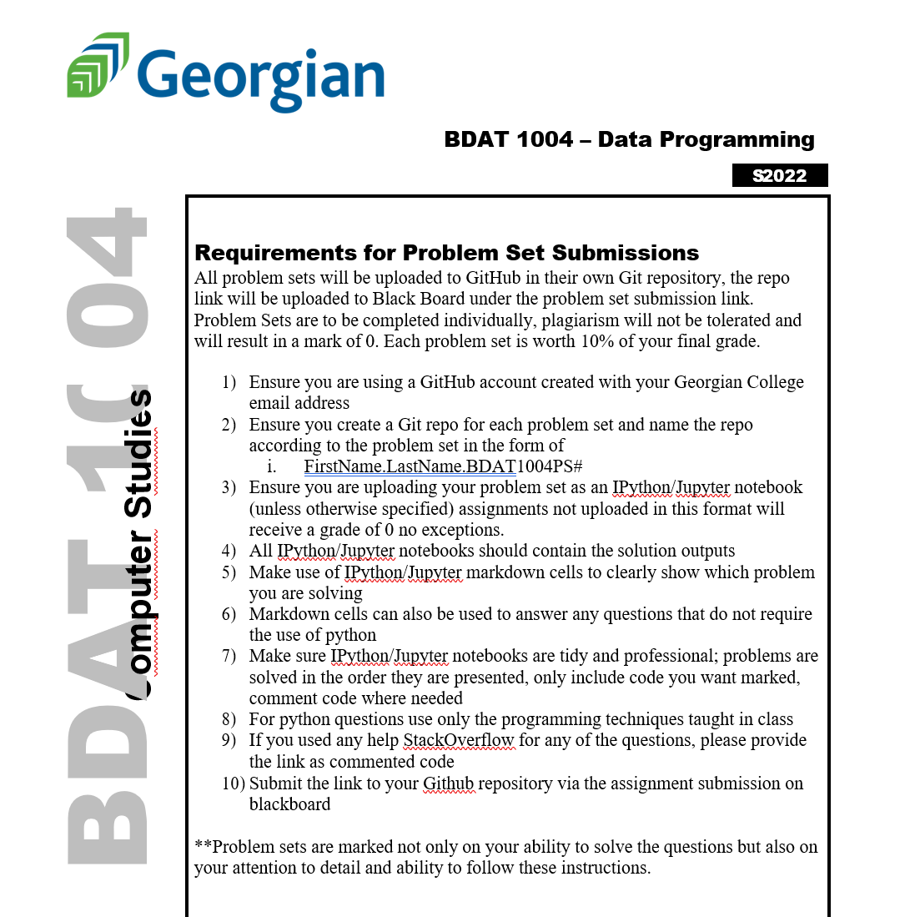

Slide 7
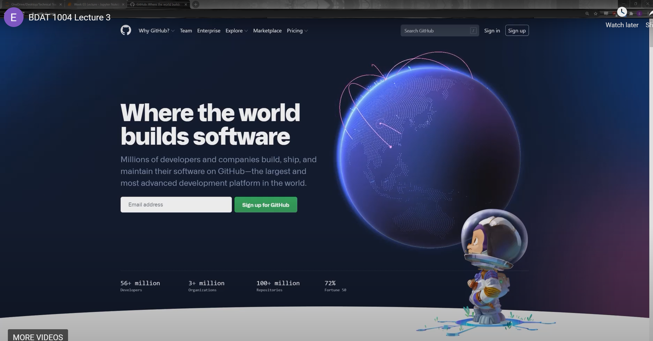
Notes:
https://github.com/

Slide 8
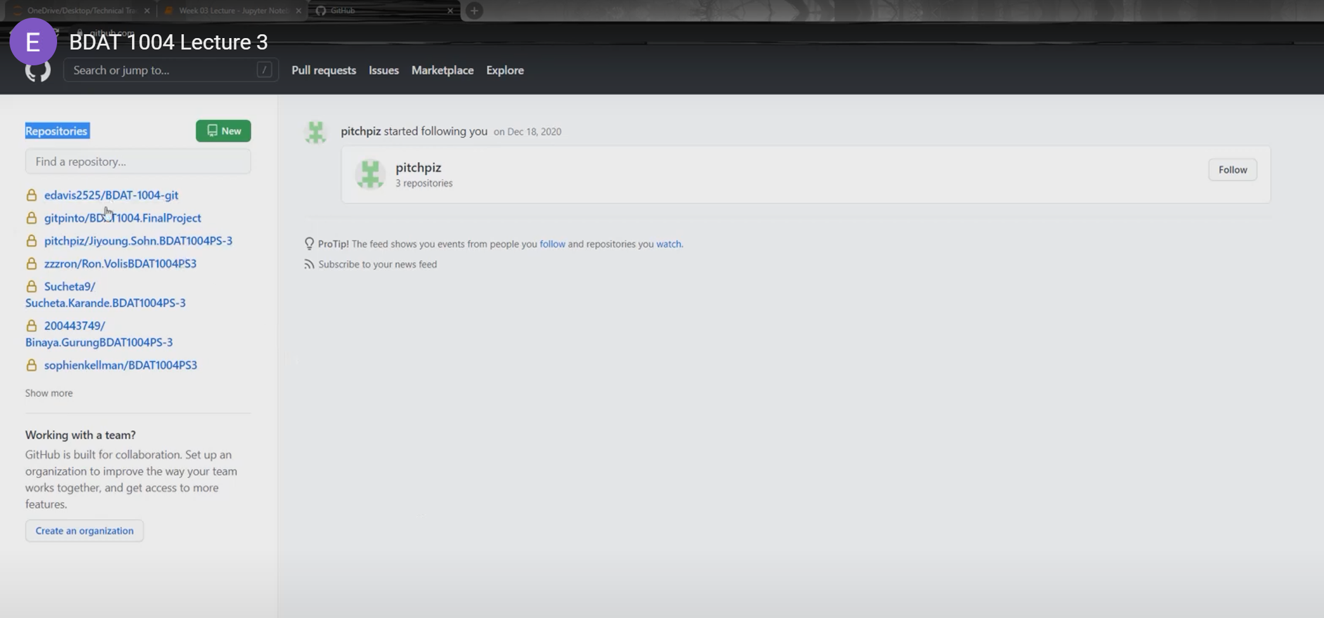

Slide 9
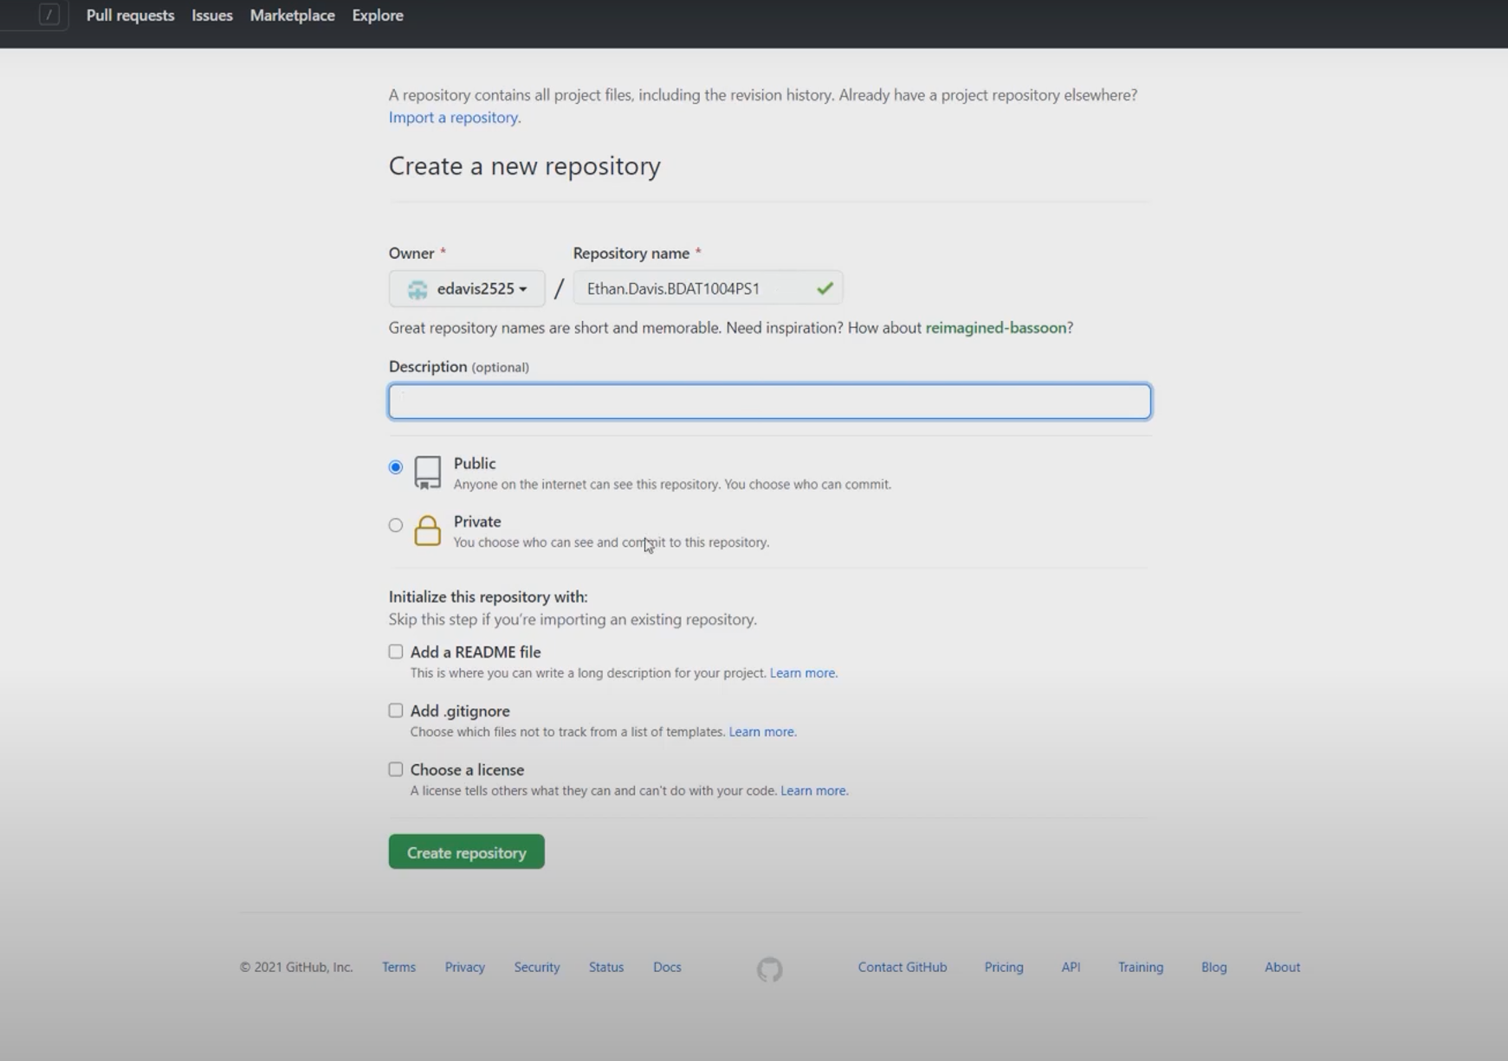

Slide 10
In Person - Any Questions?
Notes:
When will all of this content be posted?

Slide 11
Virtual - Any Questions?
Notes:
When will all of this content be posted?

Slide 12
About Python
2

Slide 13
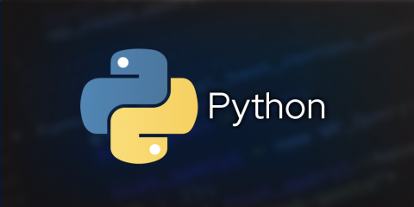
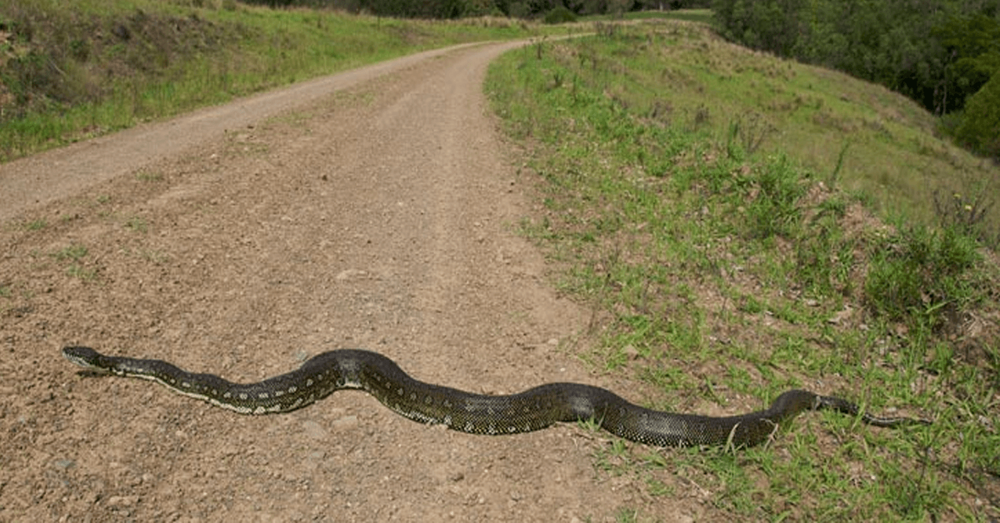
About Python
Notes:
Python is an interpreted, object-oriented, high-level programming language with dynamic semantics
Its high-level built in data structures, combined with dynamic typing and dynamic binding, make it very attractive for Rapid Application Development
Python is simple, easy to learn and it’s syntax emphasizes readability, notably using significant whitespace
Created by a Dutch programmer named Guido van Rossum in 1991. He named it after the television show Monty Python's Flying Circus
Popularity Use in data science
New vs. old programmer vibes

Slide 14
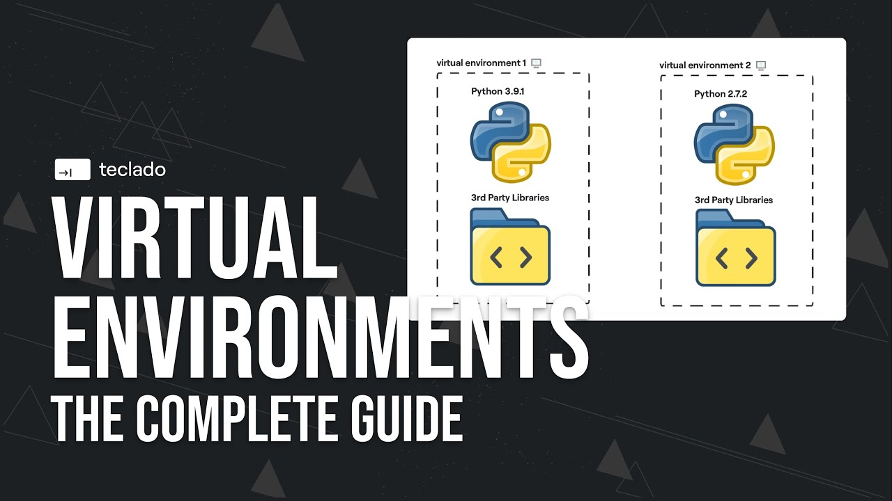
Python Environments
Notes:
There are 2 Major python environments:
Python 2.X (2.7)
The legacy version of python, still widely used but on the decline
Slide Type
Fragment
Python 3.X.X (current 3.9.0)
The future of python going forward
Better for GUI development
Most major libraries from 2. have been ported to 3
We will work mainly with python 3 for the semester
Why do we care about these environments?
Python applications will often use packages and modules that don’t come as part of the standard library. Applications will sometimes need a specific version of a library, because the application may require that a particular bug has been fixed or the application may be written using an obsolete version of the library’s interface.

Slide 15
Python Data Types
Expressions, Variables, and Assignments
Strings
Lists and Tuples
Objects and Classes
Python Standard Library
Notes:
To be explained in more detail

Slide 16
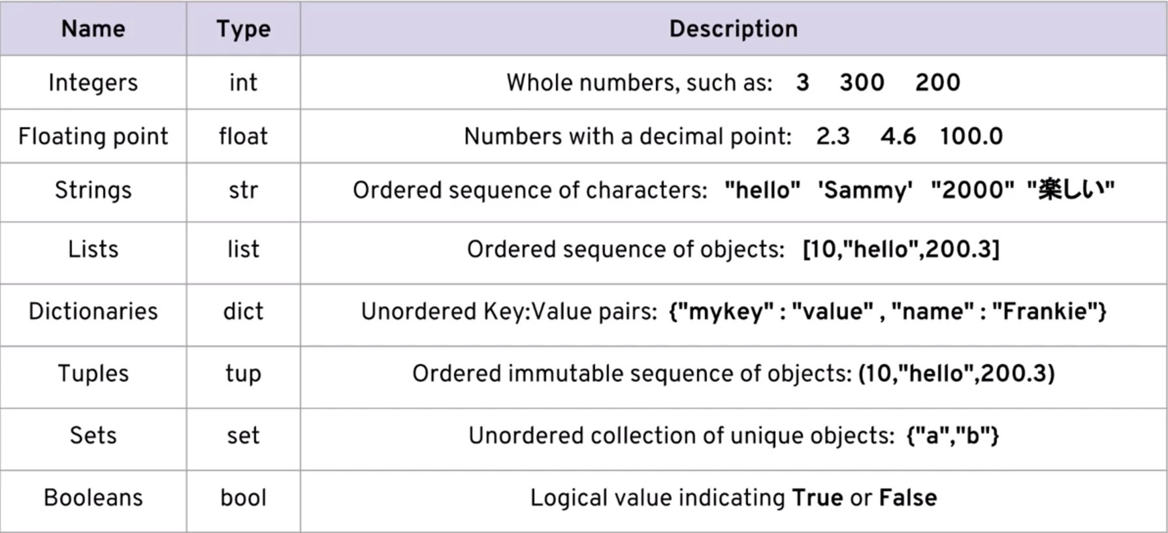
Python Data Types
Notes:
What’s different about these vs. other programming languages?
See any similarities to what we discussed next week?
Tips for industry

Slide 17
Conventions and Best Practices
Variable names can contain these characters:
a through z
A through Z
the underscore character _
digits 0 through 9
Variable names can not start with a digit, python key words can not be used as variable names
For multiple-word names use:
camelCase
the underscore as the delimiter snake_case
Notes:
Why are these and why are we doing them?

Slide 18
In Person - Any Questions?
Notes:
When will all of this content be posted?

Slide 19
Virtual - Any Questions?
Notes:
When will all of this content be posted?

Slide 20
3
Algebraic Expressions, Boolean Logic, Strings, and Indexing

Slide 21
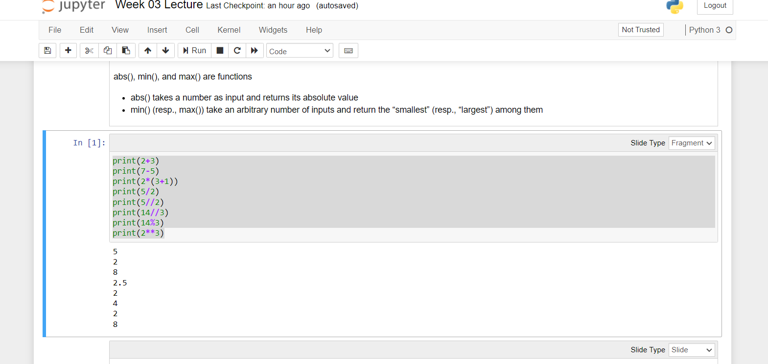
Algebraic Expressions
Notes:
The Python interactive shell or a Jupyter notebook can be used to evaluate algebraic expressions
14//3 is the quotient when 14 is divided by 3 and 14%3 is the remainder
2**3 is 2 to the 3rd power
abs(), min(), and max() are functions
abs() takes a number as input and returns its absolute value
min() (resp., max()) take an arbitrary number of inputs and return the “smallest” (resp., “largest”) among them
print(2+3)
print(7-5)
print(2*(3+1))
print(5/2)
print(5//2)
print(14//3)
print(14%3)
print(2**3)
BRACKETS

Slide 22
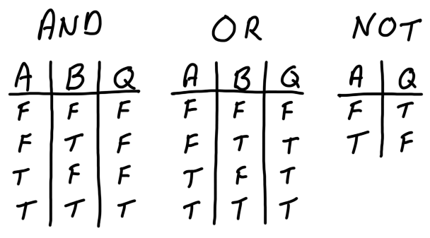
Boolean Logic
Notes:
In addition to algebraic expressions, Python can evaluate Boolean expressions
Boolean expressions evaluate to True or False
Boolean expressions often involve comparison operators >, <, ==, !=, >=, and <=
Boolean expressions may include Boolean operators and, or, and not
In an expression containing algebraic and comparison operators:
Algebraic operators are evaluated first
Comparison operators are evaluated next
Boolean operators are evaluated last

Slide 23
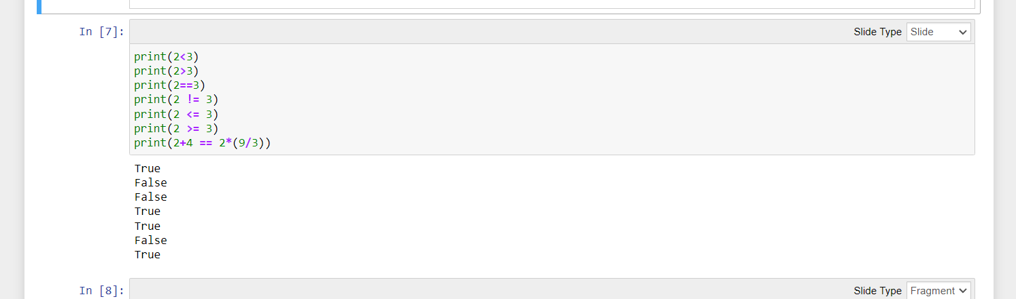
Boolean Logic Continued

Slide 24
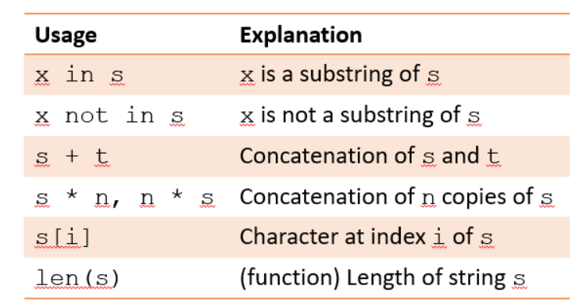
Strings
Notes:
Variable names can contain these characters:
In addition to number and Boolean values, Python support string values
A string value is represented as a sequence of characters enclosed within quotes
A string value can be assigned to a variable
String values can be manipulated using string operators and functions
Examples: Nicknames! Rosh in roshan
Practical use cases of this

Slide 25
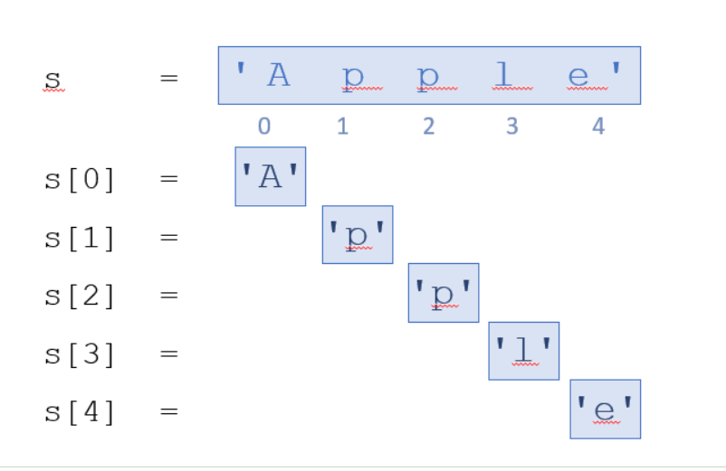
Indexing
Notes:
The index of an item in a sequence is its position with respect to the first item
The first item has index 0
The second has index 1
The third has index 2,

Slide 26
In Person - Any Questions?
Notes:
When will all of this content be posted?

Slide 27
Virtual - Any Questions?
Notes:
When will all of this content be posted?

Slide 28
3
Algebraic Expressions, Boolean Logic, Strings, Indexing, and Lists

Slide 29
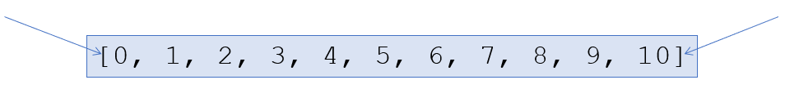
Lists
Notes:
A comma-separated sequence of items enclosed within square brackets
The items can be numbers, strings, and even other list
Lists are one of 4 built-in data types in Python used to store collections of data, the other 3 are Tuple, Set, and Dictionary, all with different qualities and usage.
They are mutable. 00:33 Once you create it, elements can be modified, individual values can be replaced,
List items are ordered, changeable, and allow duplicate values.
List items are indexed, the first item has index [0], the second item has index [1] etc.
Since lists are indexed, lists can have items with the same value:
The class tuple is the same as class list … except that it is immutable

Slide 30
Lists
Notes:
A comma-separated sequence of items enclosed within square brackets
The items can be numbers, strings, and even other list
Lists are one of 4 built-in data types in Python used to store collections of data, the other 3 are Tuple, Set, and Dictionary, all with different qualities and usage.
They are mutable. 00:33 Once you create it, elements can be modified, individual values can be replaced,
List items are ordered, changeable, and allow duplicate values.
List items are indexed, the first item has index [0], the second item has index [1] etc.
Since lists are indexed, lists can have items with the same value:

Slide 31
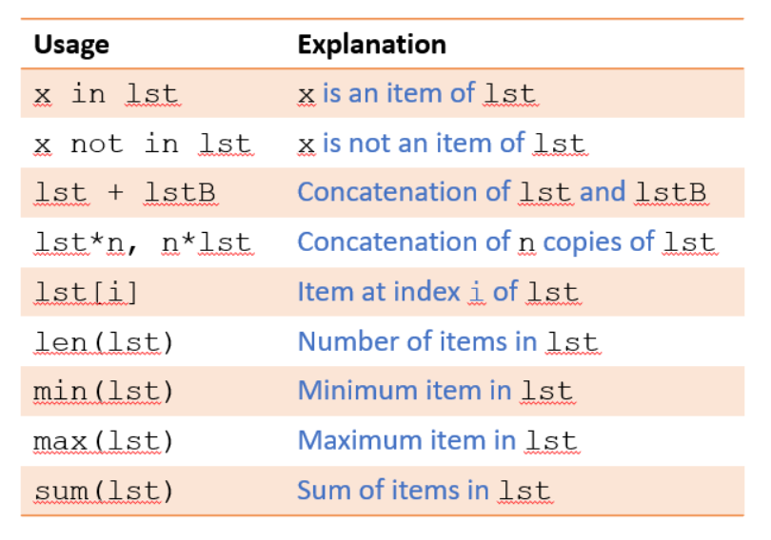

Slide 32
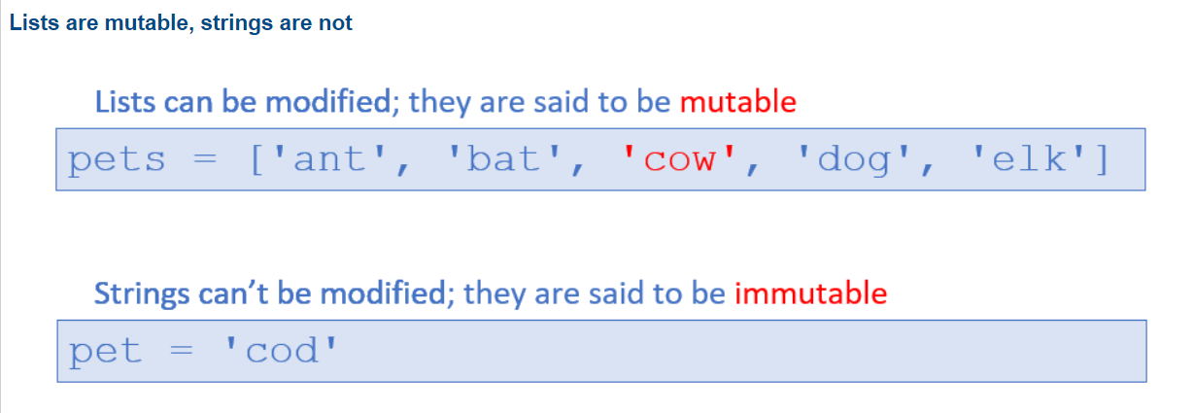

Slide 33
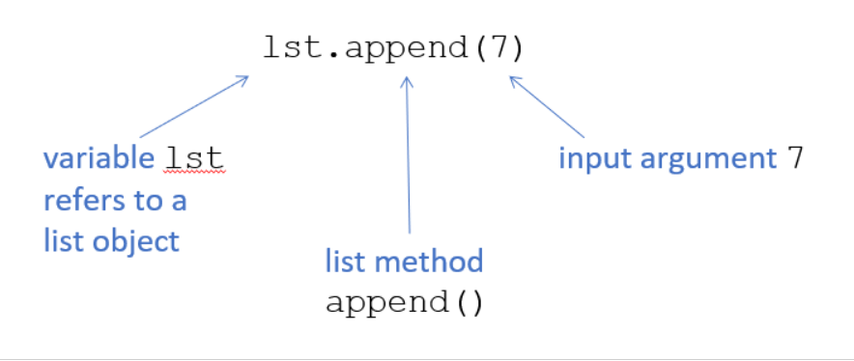
Notes:
len() and sum() are examples of functions that can be called with a list input argument; they can also be called on other type of input argument(s)
There are also functions that are called on a list; such functions are called list methods
Method append() can’t be called independently; it must be called on some list object

Slide 34
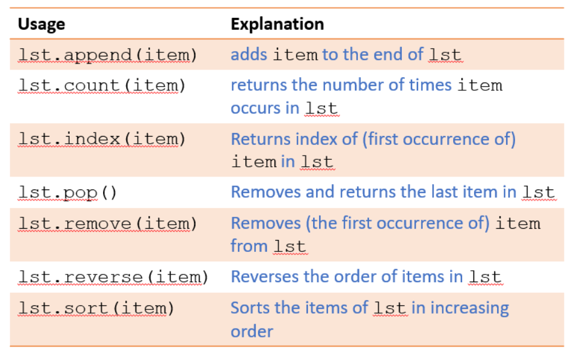
Notes:
len() and sum() are examples of functions that can be called with a list input argument; they can also be called on other type of input argument(s)

Slide 35
In Person - Any Questions?
Notes:
When will all of this content be posted?

Slide 36
Virtual - Any Questions?
Notes:
When will all of this content be posted?

Slide 37
4
Classes and Objects

Slide 38
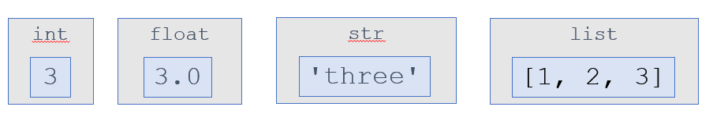
Notes:
In Python, every value, whether a simple integer value like 3 or a more complex value, such as the list ['hello', 4, 5] is stored in memory as an object.
Every object has a value and a type;
It is the object that has a type, not the variable!
An object’s type determines what values it can have and how it can be manipulated
Terminology: object X is of type int = object X belongs to class int

Slide 39
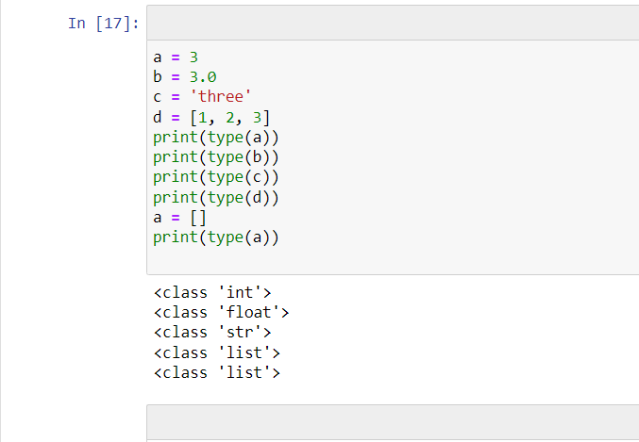

Slide 40
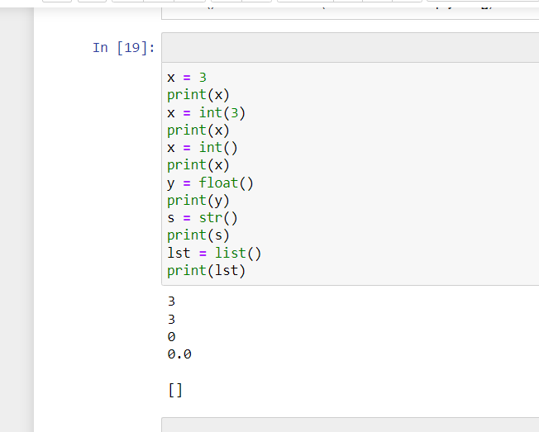
Notes:
Constructors are generally used for instantiating an object. The task of constructors is to initialize(assign values) to the data members of the class when an object of the class is created. In Python the __init__() method is called the constructor and is always called when an object is created.
default constructor: The default constructor is a simple constructor which doesn’t accept any arguments. Its definition has only one argument which is a reference to the instance being constructed.
parameterized constructor: constructor with parameters is known as parameterized constructor. The parameterized constructor takes its first argument as a reference to the instance being constructed known as self and the rest of the arguments are provided by the programmer.

Slide 41
Classes and Class Methods
In Python, every value is stored in memory as an object, every object belongs to a class (i.e., has a type), and the object’s class determines what operations can be performed on it
We saw the operations that can be performed on classes int and float
The list class supports:
operators such as +, *, in, [], etc.
methods such as append(), count(), remove(), reverse(), etc.
As programs get bigger and more complicated, they get more difficult to read. Formal languages are dense, and it is often difficult to look at a piece of code and figure out what it is doing, or why
For this reason, it is a good idea to add notes to your programs to explain in natural language what the program is doing. These notes are called comments, and in Python they start with the # symbol:

Slide 42
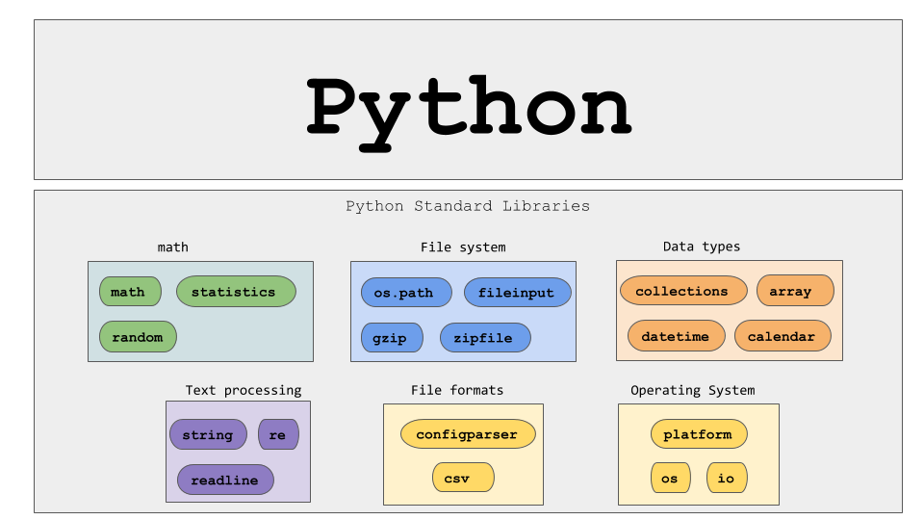
Notes:
The core Python programming language comes with functions such as max() and sum() and classes such as int, str, and list.
Many more functions and classes are defined in the Python Standard Library to support
Network programming
Web application programming
Graphical user interface (GUI) development
Database programming
Mathematical functions
Pseudorandom number generators
lMedia processing, etc.
The Python Standard Library functions and classes are organized into components called modules.
The core Python language does not have a square root function
A module must be explicitly imported into the execution environment:
The prefix math. must be present when using function sqrt()
The math module is a library of mathematical functions and constants

Slide 43
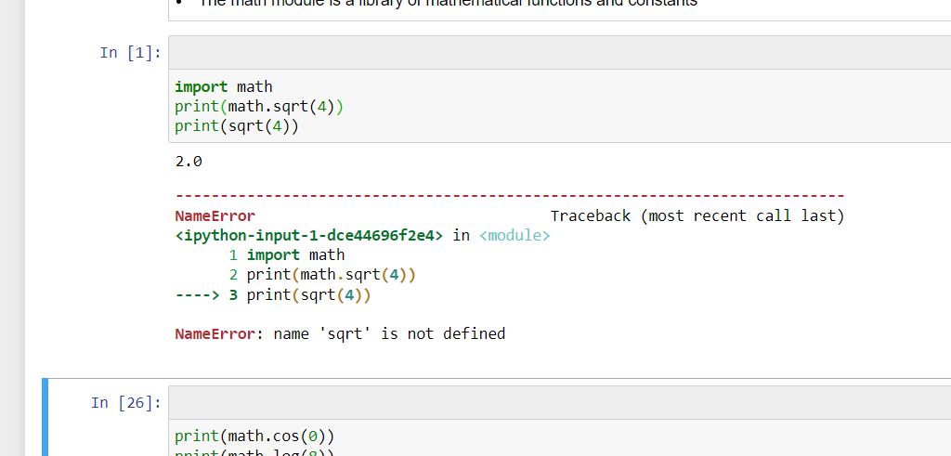

Slide 44
In Person - Any Questions?
Notes:
When will all of this content be posted?

Slide 45
Virtual - Any Questions?
Notes:
When will all of this content be posted?

Slide 46
5
Imperative Programming
Notes:
Imperative programing: functions are implicitly coded in every step required to solve a problem.
In imperative programming, every operation is coded and the code itself specifies how the problem is to be solved, which means that pre-coded models are not called on.
The written code performs the functions instead of models, the programmer must code each step
Imperative programming contrasts with declarative programming, in which how a problem is solved is not specifically defined, but instead focuses on what needs to be solved.
Now let’s focus on more Python functions that are ready to access that can help make our programs more interesting

Slide 47
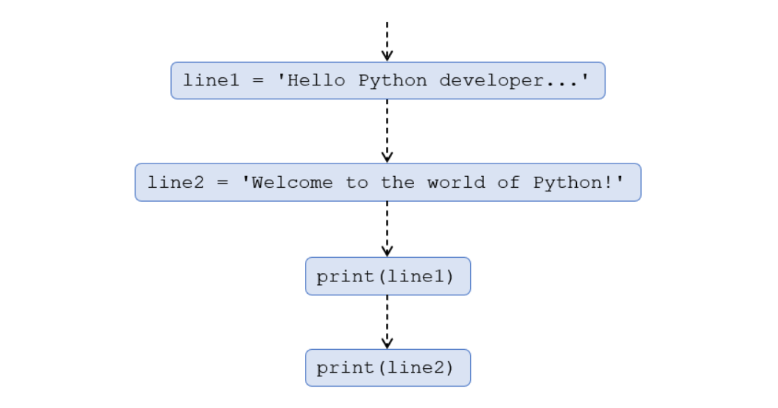
Notes:
A Python program is a sequence of Python statements
Stored in a text file called a Python moduleExecuted using an IDE or “from the command line”

Slide 48
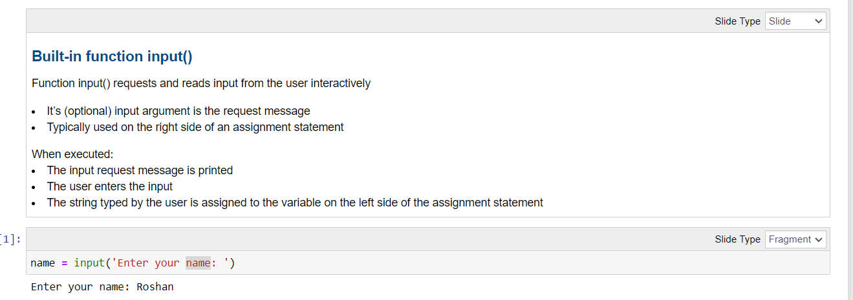

Slide 49
In Person - Any Questions?
Notes:
When will all of this content be posted?

Slide 50
Virtual - Any Questions?
Notes:
When will all of this content be posted?

Slide 51
6
If Else Logic

Slide 52
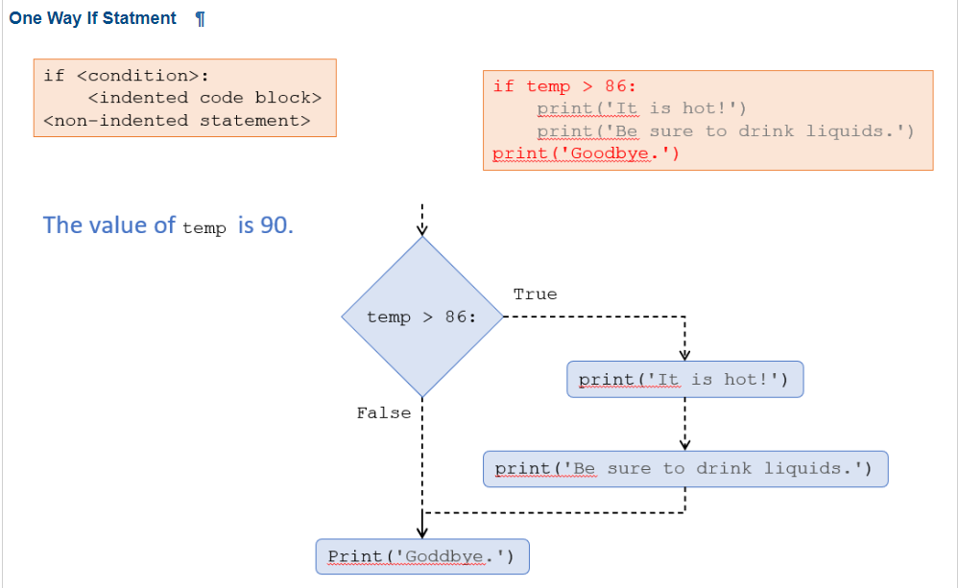
Notes:
Spaces. Matter!

Slide 53
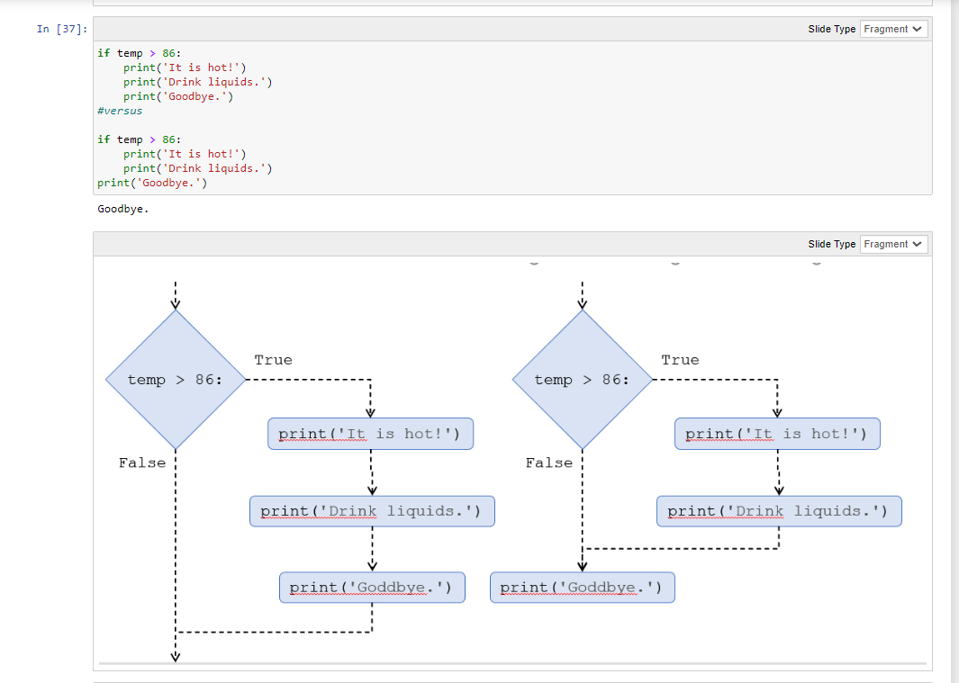
Notes:
Spaces. Matter!

Slide 54
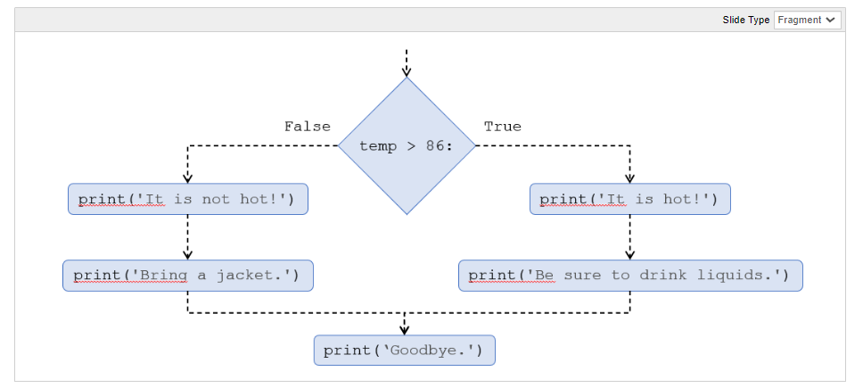

Slide 55
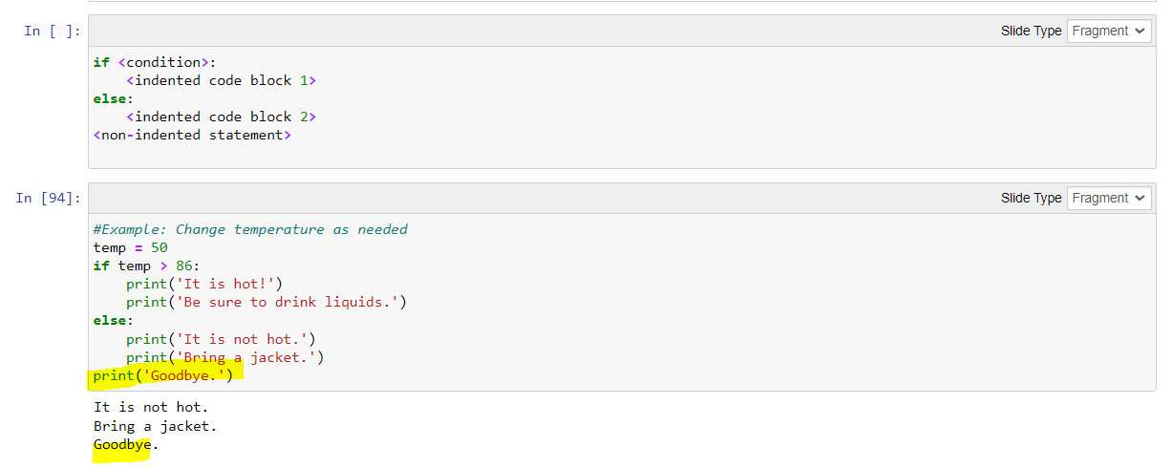
Notes:
When is an example of a use case in real life when we would want to send the end user a message regardless of how their interaction with the program goes?

Slide 56
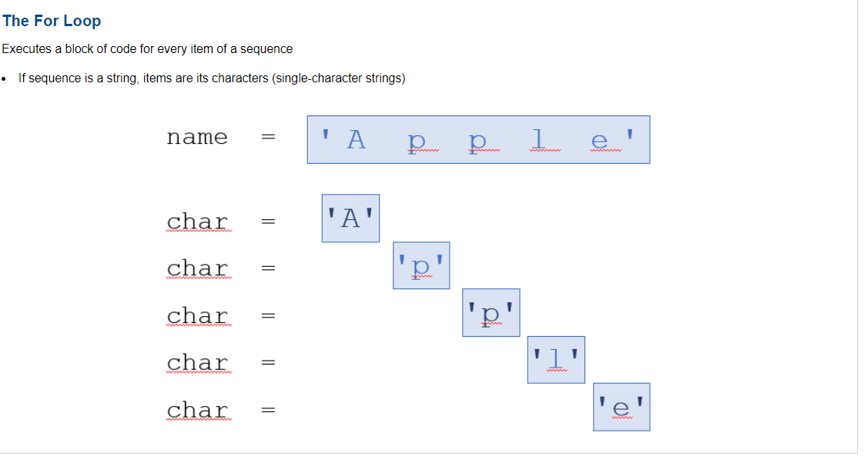
Notes:
Executes a block of code for every item of a sequence
Executes a block of code for every item of a sequence
If sequence is a string, items are its characters (single-character strings)
Sequence can be a string, a list, …Block of code must be indented

Slide 57
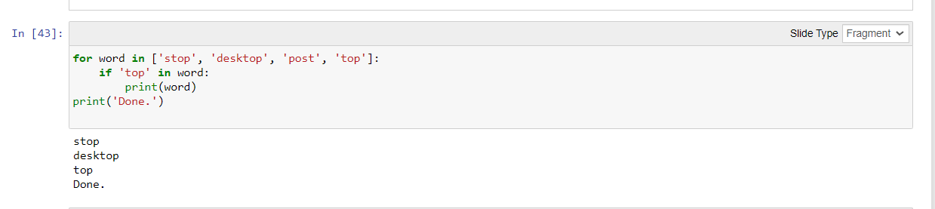
Notes:
Executes a block of code for every item of a sequence
Executes a block of code for every item of a sequence
If sequence is a string, items are its characters (single-character strings)
Sequence can be a string, a list, …Block of code must be indented

Slide 58
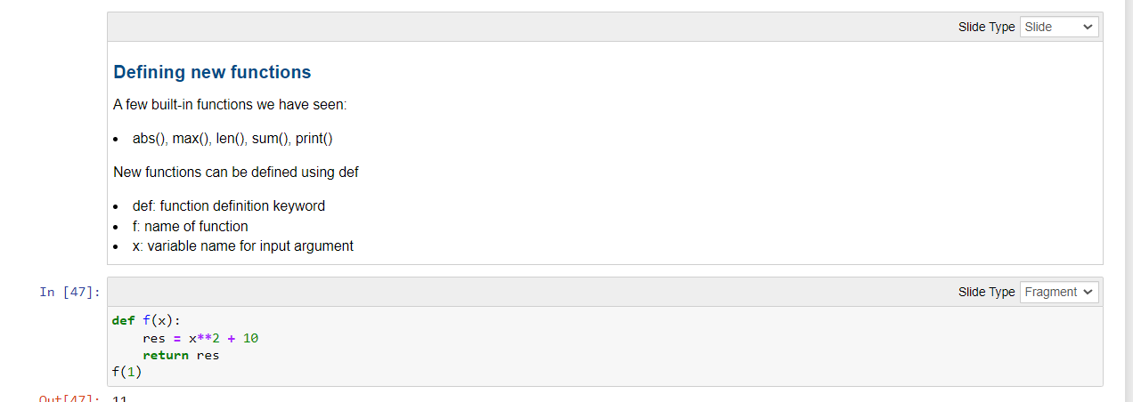
Notes:
A few built-in functions we have seen:
abs(), max(), len(), sum(), print()
New functions can be defined using def
def: function definition keyword
f: name of function
x: variable name for input argument
print() vs return
Function returns value of res which can then be used in an expression
Function prints value of res but does not return anything

Slide 59
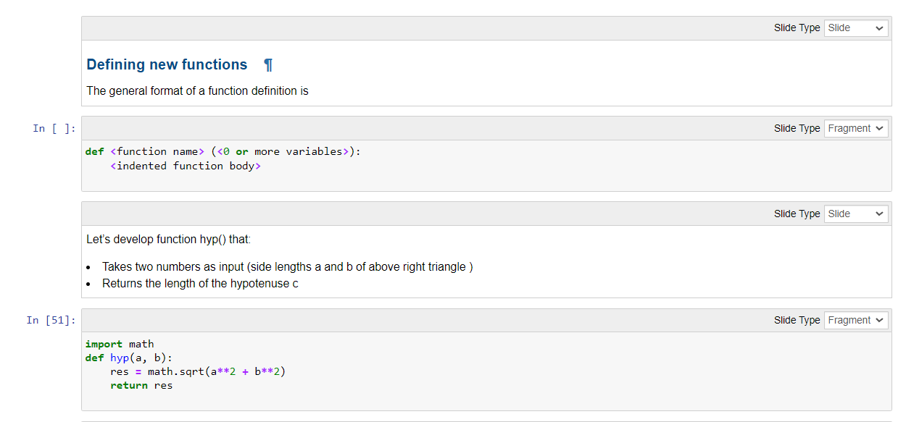

Slide 60
In Person - Any Questions?
Notes:
When will all of this content be posted?

Slide 61
Virtual - Any Questions?
Notes:
When will all of this content be posted?

Slide 62
7
Text Data, File I/O, and Exceptions

Slide 63
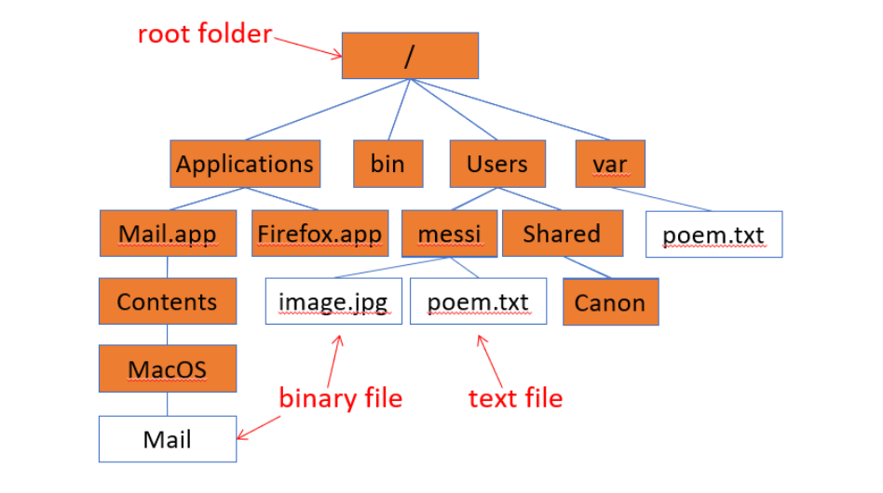
Notes:
Opening and closing a file
The file system is the OS component that organizes files and provides a way to create, access, and modify files
Processing a file consists of:
Opening the file
Reading from and/or writing to the file
Closing the file
Built in function open() is used to open a file
The first input argument is the file pathname, whether absolute or relative with respect to the current working directory
The second optional argument is the file mode such as r or w
A “file” object is of a type that supports several “file” methods, including method close() that closes the file

Slide 64
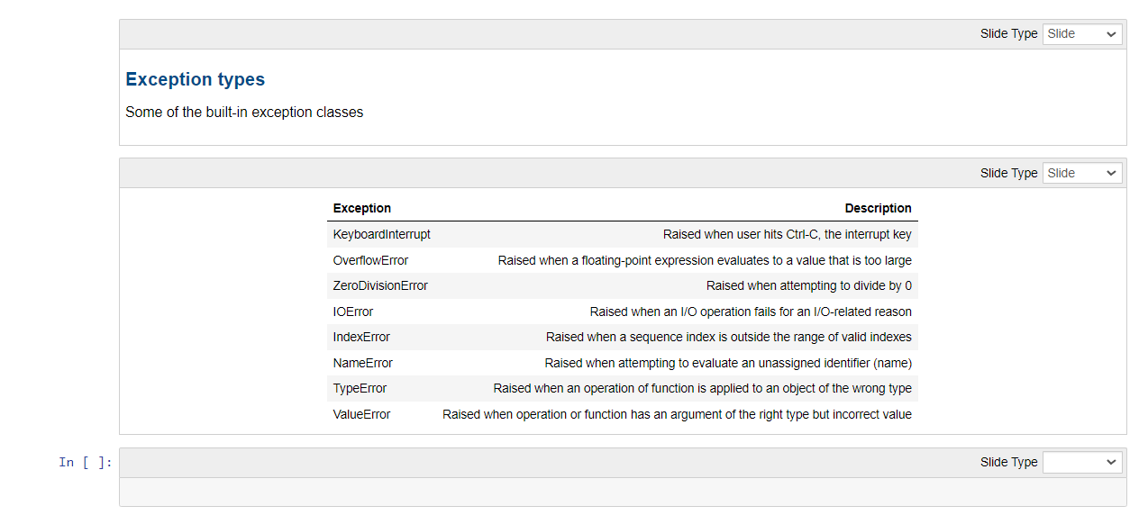

Slide 65
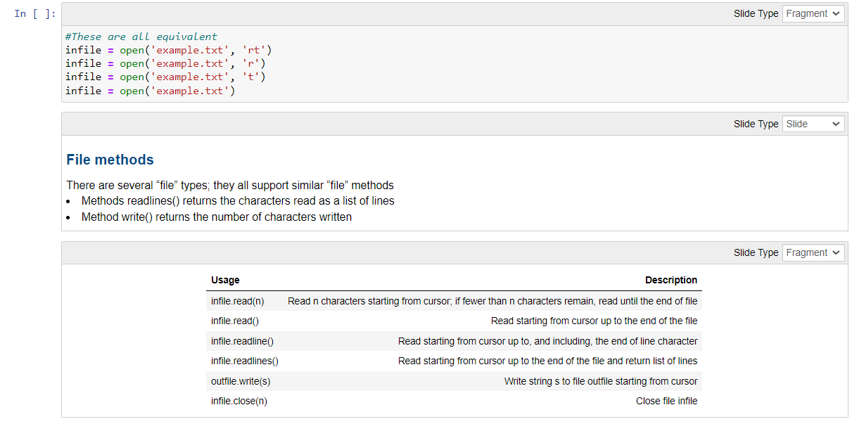

Slide 66
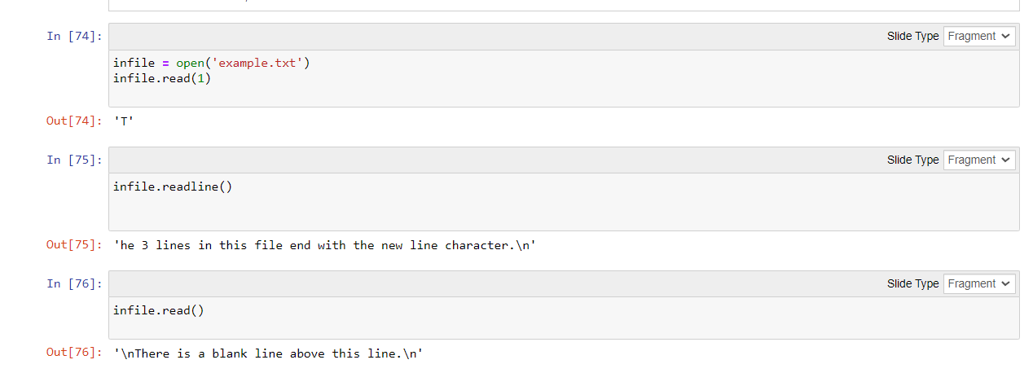

Slide 67
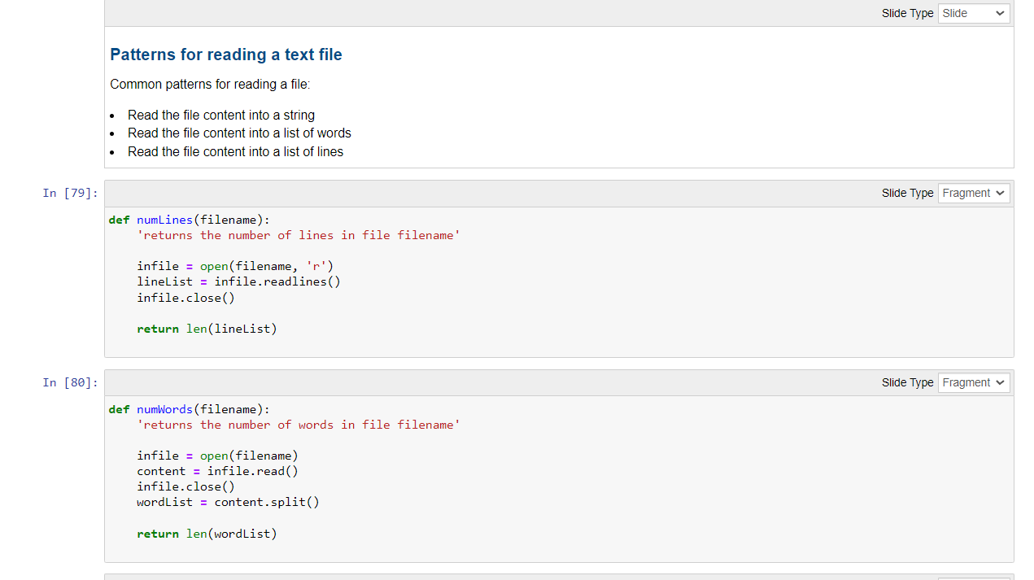

Slide 68
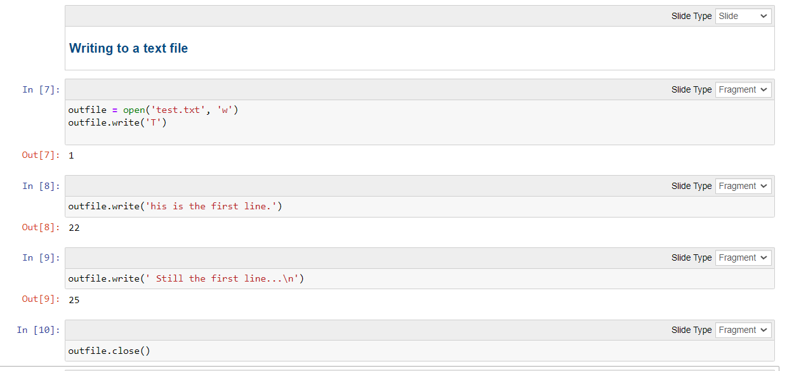

Slide 69
In Person - Any Questions?
Notes:
When will all of this content be posted?

Slide 70
Virtual - Any Questions?
Notes:
When will all of this content be posted?

Slide 71
Practice Questions
8

Slide 72
Exercises #1: Expressions and Operators
The difference between Annie’s age (25) and Ellie’s (21)
The total of $14.99, $27.95, and $19.83
The area of a rectangle of length 20 and width 15
2 to the 10th power
3 equals 4-2
The minimum of 3, 1, 8, -2, 5, -3, and 0
The value of 17//5 is 3
The value of 17%5 is 3
284 is even
284 is even and 284 is divisible by 3
284 is even or 284 is divisible by 3

Slide 73
Exercises #2: Boolean Logic
True and True
False and True
1 == 1 and 2 == 1
"test" == "test"
1 == 1 or 2 != 1
True and 1 == 1
False and 0 != 0
True or 1 == 1
"test" == "testing"
1 != 0 and 2 == 1

Slide 74
Exercises #3: Strings
Write Python expressions involving strings s1, s2, and s3 that correspond to:
'll' appears in s3
the blank space does not appear in s1
the concatenation of s1, s2, and s3
the blank space appears in the concatenation of s1, s2, and s3
the concatenation of 10 copies of s3
the total number of characters in the concatenation of s1, s2, and s3

Slide 75
Exercises #4: Indexing
String s is defined to be 'abcdefgh'
Write expressions using s and the indexing operator [] that return the following strings:
'a'
'c'
'h'
'f'

Slide 76
Exercises #5: Lists
List lst is a list of prices for a pair of boots at different online retailers
You found another retailer selling the boots for $160.00; add this price to list lst
Compute the number of retailers selling the boots for $160.00
Find the minimum price in lst
Using c), find the index of the minimum price in list lst
Using c) remove the minimum price from list lst
Sort list lst in increasing order

Slide 77
Exercises #6: Classes
Write a Python expression that assigns to variable c
The length of the hypotenuse in a right triangle whose other two sides have lengths 3 and 4
The value of the Boolean expression that evaluates whether the length of the above hypotenuse is 5
The area of a disk of radius 10
The value of the Boolean expression that checks whether a point with coordinates (5, 5) is inside a circle with center (0,0) and radius

Slide 78
Exercises #7: Python Functions
Write a program that:
Requests the user’s name
Requests the user’s age
Computes the user’s age one year from now and prints the message shown

Slide 79
Exercises #8: If Else Logic
Write a program that:
Requests the user’s name
Requests the user’s age
Prints a message saying whether the user is eligible to vote or not

Slide 80
Exercises #9: Creating Functions
Write function hello() that:
takes a name (i.e., a string) as input
prints a personalized welcome message
Note that the function does not return anything
Write function rng() that:
takes a list of numbers as input
returns the range of the numbers in the list
The range is the difference between the largest and smallest number in the list

Slide 81
To Do List
Download and open this week's notebook
Read the weekly learning
Complete Quiz 2
Consider completing practice questions
Review the Problem Set Submission Document
Work on Problem Set 1
Notes:
Using the materials on blackboard .. They are your tools for the problem set

Slide 82
Deliverables
Quiz #2: Due by 11:59PM on Thursday September 22nd
Problem Set #1: Due by 11:59PM on Tuesday October 4th

Slide 83

Best Practices for Emailing Me
Email is the best way to contact me
Roshan.Sahu@georgiancollege.ca
Reply within 48 hours

Slide 84
In Person - Any Questions?
Notes:
When will all of this content be posted?

Slide 85
Virtual - Any Questions?
Notes:
When will all of this content be posted?

